Slide 1
Milan Fashion Week
By Lightbringers
ISHITA JOSHI
RUTWIK GHAG
SIDDHI BHANDARI

Slide 2
01
BUSINESS PROBLEM & PROPOSAL

Slide 3
BUSINESS PROBLEM AND PROPOSAL
This Database Management System is a Business Model for the management of the Milan Fashion Week Event
The Database includes data about:
Models, their fees, the brands they are associated to
Managers, the models they manage, their fees
Brands, the type of clothes they will display, the item type and the season
Designers, their designing forte, the brand their associated with
Judges, the season their judging, the model they voted for
Staff, who they are allocated to, their department
Guests, their status, seating priority, staff allotted to them, their vote
Deliverable:
On demand data whatever is required
Winners calculated by votes
Pay calculations

Slide 4
03
ER DIAGRAMS

Slide 5
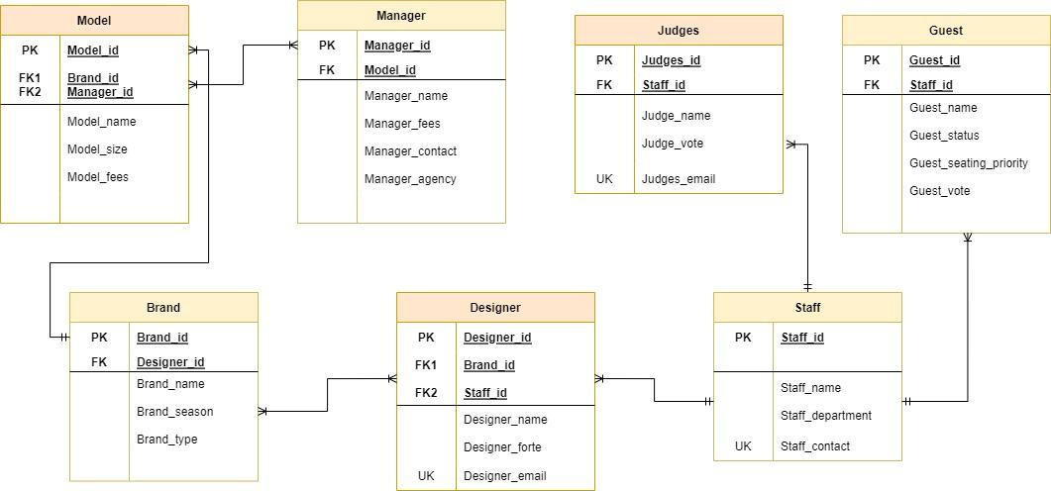
PROJECT SCHEDULE
01
PROJECT TIMELINE
02
AGENDA
STATUS REPORT
03
UPCOMING REPORT
04
Topic of the section
Topic of the section
Topic of the section
Topic of the section

Slide 6
04
SQL Queries

Slide 7
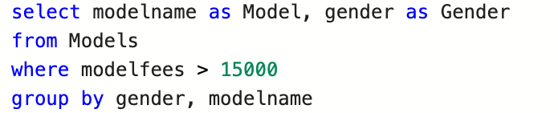
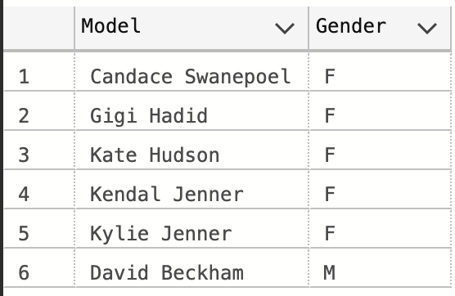
To find models paid more than 15,000
PROJECT SCHEDULE
01
PROJECT TIMELINE
02
STATUS REPORT
03
UPCOMING REPORT
04
Topic of the section
Topic of the section
Topic of the section
Topic of the section

Slide 8
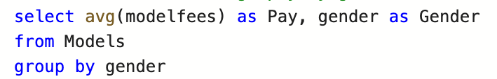
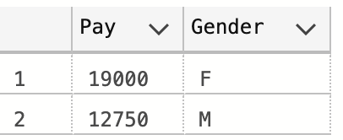
To find the average pay by gender for models
PROJECT SCHEDULE
01
PROJECT TIMELINE
02
STATUS REPORT
03
UPCOMING REPORT
04
Topic of the section
Topic of the section
Topic of the section
Topic of the section

Slide 9
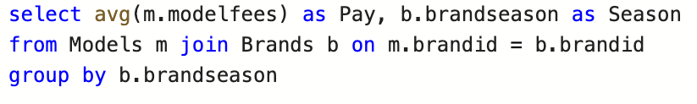
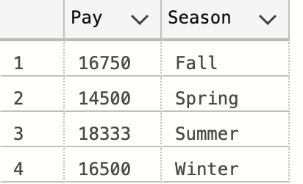
To find the average pay by season for models
STATUS REPORT
03
UPCOMING REPORT
04
Topic of the section
Topic of the section
Topic of the section

Slide 10
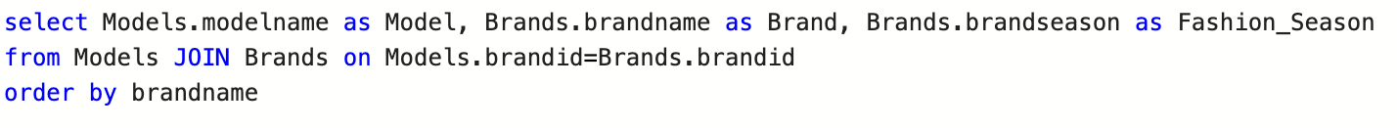
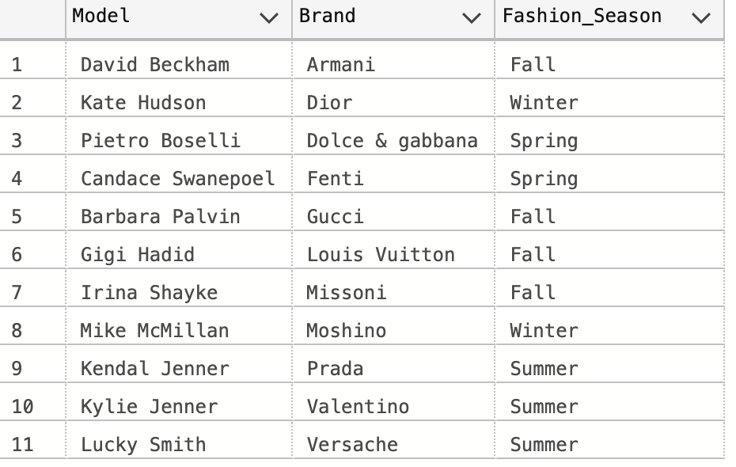
To find the brands and season presented by the models

Slide 11
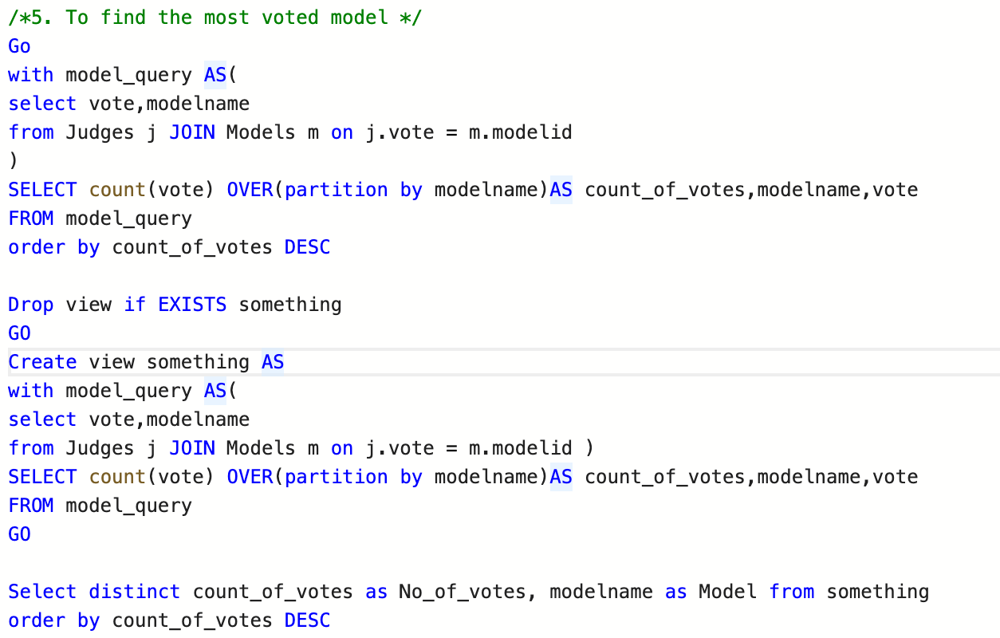
To find the most voted model

Slide 12
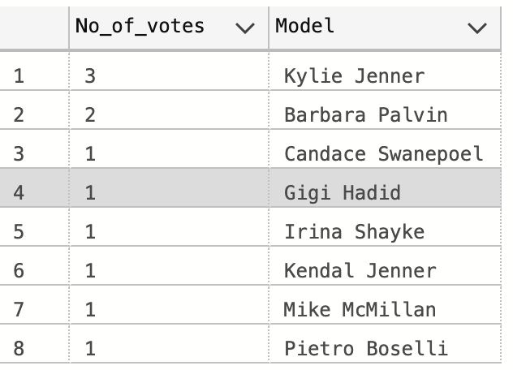

Slide 13
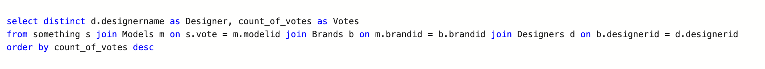
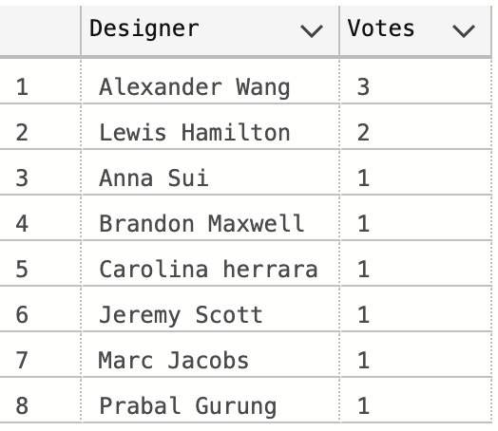
To find the winner designer

Slide 14
05
WEBSITE

Slide 15

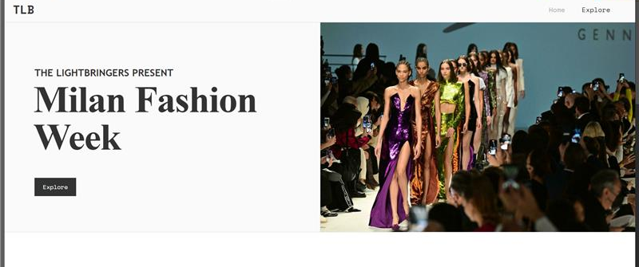
WEBSITE

Slide 16
Thank You!

